Slide 1
APPLICATION FOR MANAGING VETERINARY POLYCLINIC
PROJECT GUIDE-MRS.PRANJALI DESHPANDE
1. SHALINI PRASANNA EXAM NO-B120204364
2. T. PAVITHRA EXAM NO-B120204409
3. SUPRIYA WAGHMARE EXAM NO-B120204404
4. ASHLESHA WAIKOS EXAM NO-B120204424

Slide 2
PROBLEM DEFINITION
Application for managing a Veterinary Polyclinic.

Slide 3
MOTIVATION
To automate the manually maintained record process.
Due to the limitations of the currently used handwritten systems like data redundancy, data loss, data inconsistency.

Slide 4
FUTURE SCOPE
A mobile application can be developed, to access clinical data via smartphones.
Medicine inventory can be added as a part of the clinical dbms.
The patients can make appointments using the system will be a part of the future development.

Slide 5
OBJECTIVES AND PLANNED OUTCOME
Creating a web application for a veterinary polyclinic by the means of SQL database
The patient records should be generated and recorded into the database systematically and can be looked up by the doctors when needed.
The desired outcome is for the reports to be generated and displayed.

Slide 6
LITERATURE SURVEY
Database management system is currently implemented in the Radiology department in the Malaysian hospitals[1].
External Schema: Specifies the part of the database to be viewed.
Internal Schema: Specifies how data is physically stored and accessed.
Conceptual Schema: Specifies data stored in terms of data model.
Hospital database workload and fault forecasting[2] paper, a system maintains the hospital records. It is called the Hospital Information System (HIS). It consists of 4 processes: Care, Clinical process, Management and Resource. AIDA (Agency for Integration, Diffusion and Archive of Medical Information.

Slide 7
The ship building industry[3] uses legacy system to introduce web based mobile technology. It is a cost involving process. SOAP based services have a standardized approach and can replace RPC. REST-ful web services CPU be extended to web and module platform.
In Web database application system optimization[4] paper, It has to face a large group of users. Therefore, system needs optimization. Optimization of server and Web application system optimization

Slide 8
SYSTEM MODULES
1. Login Module:
i. A login page for authorization.
ii. Input details authorised with the saved staff records.
2. Registration Module:
i. For registering new patient details.
ii. Registration module for the staff (doctors).
iii. Patient and staff details saved in a database.

Slide 9
3. Departments/Inventory module:
i. MySQL database for every department.
ii. Records can be viewed efficiently.
iii. Inventory details of liquid nitrogen are maintained in a separate database.
4. Report generation:
i. Final reports of vaccination, liquid nitrogen inventory, surgery, revenue and summary generated.
5. SMS Remainder module:
i. Automated SMS Reminder system for the insemination patients.

Slide 10
Login Module
Patient Registration Module
Department Module/Inventory
Automated SMS reminder Module
Report Generation Module

Slide 11
SYSTEM ARCHITECTURE

Slide 12
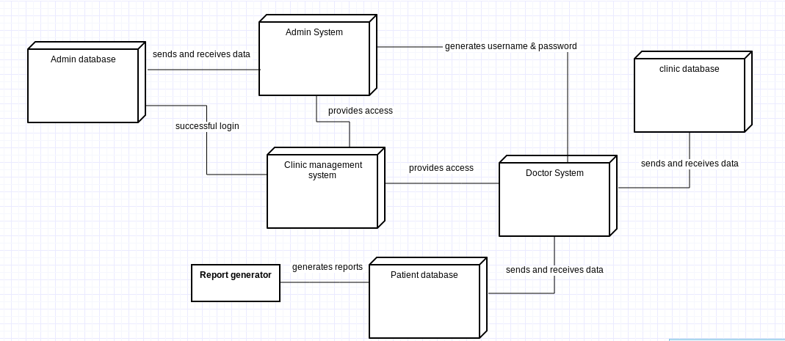

Slide 13
UNIFIED MODELLING LANGUAGE DIAGRAM

Slide 14
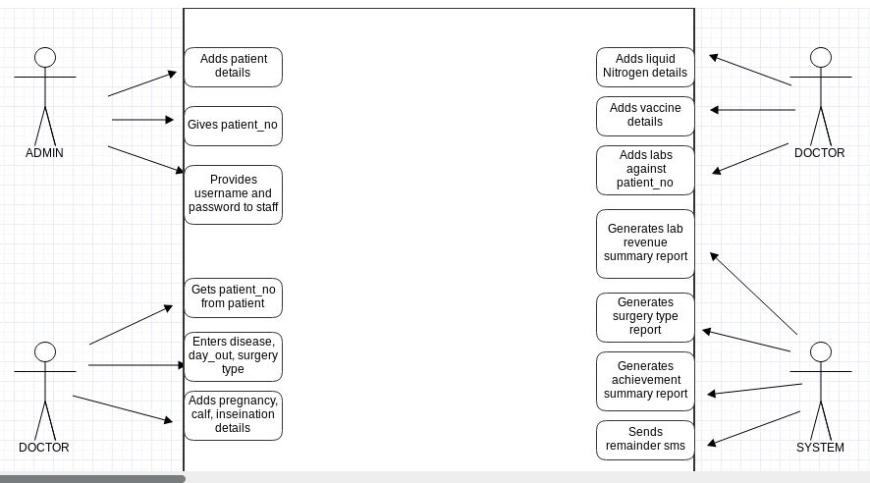

Slide 15
CLASS DIAGRAMS

Slide 16
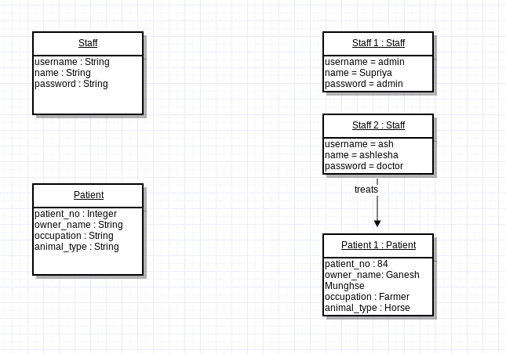

Slide 17
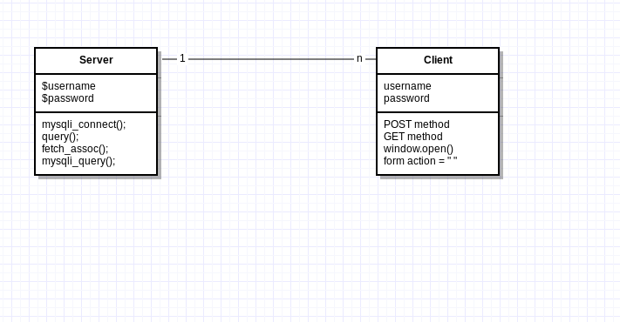

Slide 18
STATE TRANSITION DIAGRAM

Slide 19
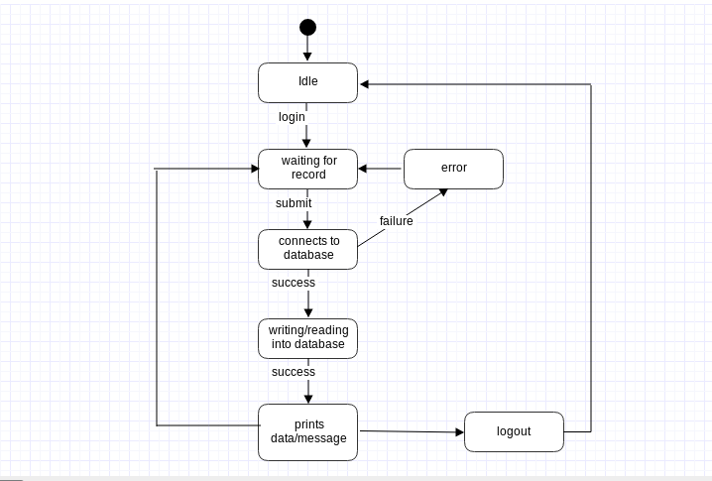

Slide 20
NETWORK DIAGRAM

Slide 21
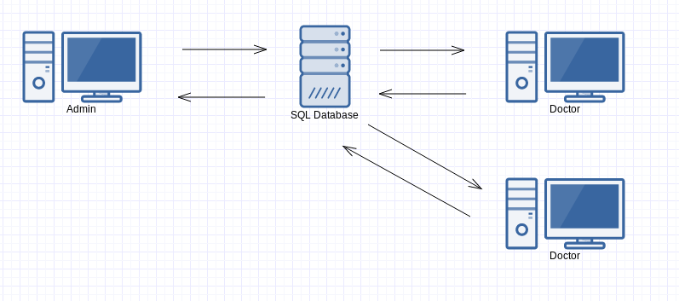

Slide 22
TIMELINE CHART

Slide 23
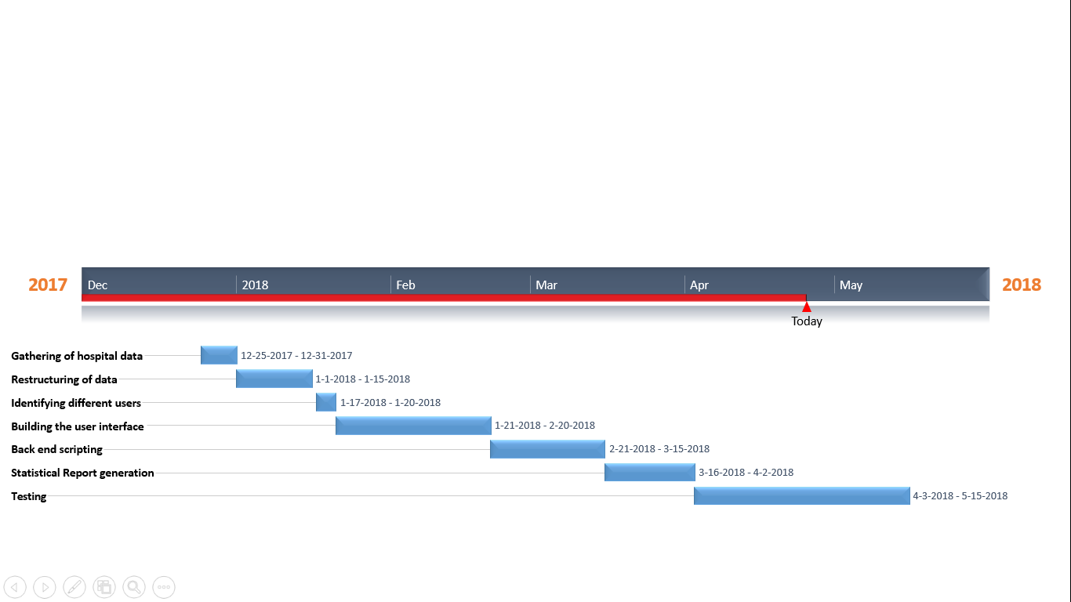

Slide 24
ACTIVITY DIAGRAM

Slide 25
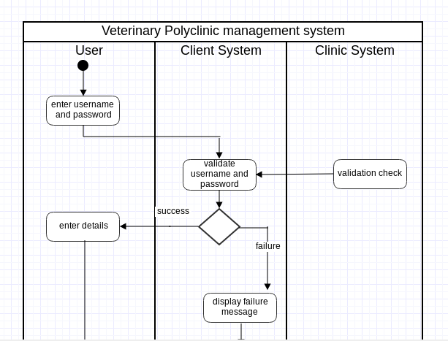
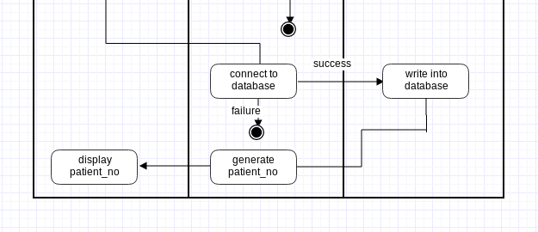

Slide 26
SEQUENCE DIAGRAM

Slide 27
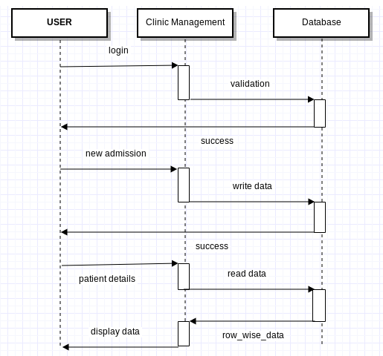

Slide 28
DATA FLOW DIAGRAM

Slide 29
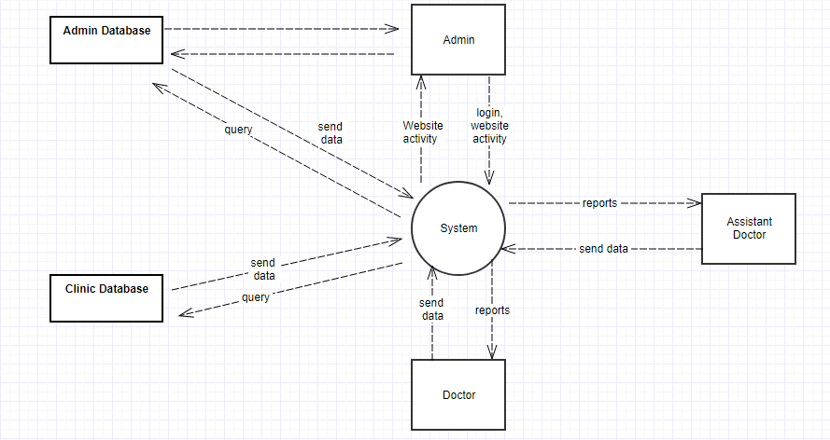

Slide 30
CONCLUSION
The system will automate all handwritten records.
The system will have a higher efficiency.
Low cost, better security and storage.
Easy access from anywhere.
Automated monthly/yearly reports for a better reference.
Ensures data integrity, data persistency, data accessibility.

Slide 31
REFERENCE
[1] K. S. Sim, T. K. Kho, F. S. Abas, F. F. Ting, V. Teh and C. S. Ee, “Computerized Brain Database Management System for Radiological Department in Hospital,” International Conference of Robotics, Automation and Sciences(ICORAS), 2016.
[2] Paulo Silva, Cesar Quintas, J´ulio Duarte, Manuel Santos, Jos´e Neves, Ant´onio Abelha and Jos´e Machado, “Hospital database workload and fault forecasting,” IEEE-EMBS Conference on Biomedical Engineering and Sciences, pp. 63-68, 2012.
[3] Jeong-cheol Jeon, Jaehwa Chung, “Developing a Prototype of REST-based Database Application for Shipbuilding Industry: A Case Study,” International Conference on Platform Technology and Service (PlatCon), pp. 1-6, 2017.
[4] Cheng Zhi, “The Web database application system optimization research,” Seventh International Conference onMeasuring Technology and Mechatronics Automation, pp. 1329-1332, 2015.

Slide 32
THANK YOU!!!!

